Slide 1
Sentiment Analysis on Mentors Feedback

Slide 2
Algorithm Used
Multinomial Naïve Bayes Classifier

Slide 3
Multinomial Naïve Bayes Classifier
This is why it’s naïve!

Slide 4
Multinomial Naïve Bayes Independence Assumptions
Bag of Words assumption
Assume position doesn’t matter
Conditional Independence
Assume the feature probabilities P(x_{i}|c) are independent given the class c.

Slide 5
Learning the Multinomial Naïve Bayes Model
First attempt: maximum likelihood estimates
simply use the frequencies in the data

Slide 6
Parameter Estimation
fraction of times word w_{i} appears
among all words in documents of topic c_{j}
Create mega-document for topic j by concatenating all docs in this topic
Use frequency of w in mega-document

Slide 7
Problem with Maximum Likelihood
What if we have seen no training documents with the word fantastic and classified in the topic positive (thumbs-up)?
Zero probabilities cannot be conditioned away, no matter the other evidence!

Slide 8
Laplace Smoothing

Slide 9
Multinomial Naïve Bayes: Learning
From training corpus, extract Vocabulary
Calculate P(c_{j}) terms
For each c_{j} in C do
docs_{j} ← all docs with class =c_{j}
Calculate P(w_{k} | c_{j}) terms
Text_{j} ← single doc containing all docs_{j}
For each word w_{k} in Vocabulary
n_{k} ← # of occurrences of w_{k} in Text_{j}

Slide 10


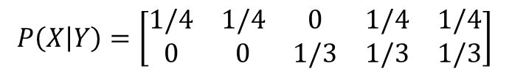

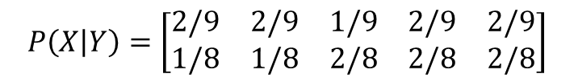
Example
$$P\left(Y\right)=\left[\begin{matrix}1/2 & 1/2\end{matrix}\right]$$
Features = {I hate love this book}
Training
I hate this book
Love this book
What is P(Y|X)?
Prior p(Y)
Testing
hate book
Different conditions
a = 0 (no smoothing)
a = 1 (smoothing)
$$M=\left[\begin{matrix}1 & 1 & 0 & 1 & 1 \\ 0 & 0 & 1 & 1 & 1\end{matrix}\right]$$
$$P\left(X | Y\right)=\left[\begin{matrix}1/4 & 1/4 & 0 & 1/4 & 1/4 \\ 0 & 0 & 1/3 & 1/3 & 1/3\end{matrix}\right]$$
$P\left(Y|X\right) ∝ \left[\begin{matrix}1/2×1/4×1/4 & 1/2×0×1/3\end{matrix}\right]$ = $\left[1 0\right]$
$$M=\left[\begin{matrix}2 & 2 & 1 & 2 & 2 \\ 1 & 1 & 2 & 2 & 2\end{matrix}\right]$$
$$P\left(X | Y\right)=\left[\begin{matrix}2/9 & 2/9 & 1/9 & 2/9 & 2/9 \\ 1/8 & 1/8 & 2/8 & 2/8 & 2/8\end{matrix}\right]$$
$P\left(Y|X\right) ∝ \left[\begin{matrix}1/2×2/9×2/9 & 1/2×1/8×2/8\end{matrix}\right]$ = $\left[0.613 0.387\right]$

Slide 11

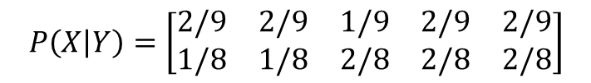
Example
$$P\left(Y\right)=\left[\begin{matrix}1/2 & 1/2\end{matrix}\right]$$
$$P\left(X | Y\right)=\left[\begin{matrix}2/9 & 2/9 & 1/9 & 2/9 & 2/9 \\ 1/8 & 1/8 & 2/8 & 2/8 & 2/8\end{matrix}\right]$$
$P\left(Y|X\right) ∝ \left[\begin{matrix}1/2×2/9×2/9 & 1/2×1/8×2/8\end{matrix}\right]$ = $\left[0.613 0.387\right]$

Slide 12
Why Multinomial Naïve Bayes ?
When assumption of independent predictors holds true, a Naive Bayes classifier performs better as compared to other models.
Naive Bayes requires a small amount of training data to estimate the test data. So, the training period is less.
Naive Bayes is also easy to implement.

Slide 13
Naïve Bayes Intuition
Simple (“naïve”) classification method based on Bayes rule
Relies on very simple representation of document
Bag of words

Slide 14
Bag of Words

Slide 15
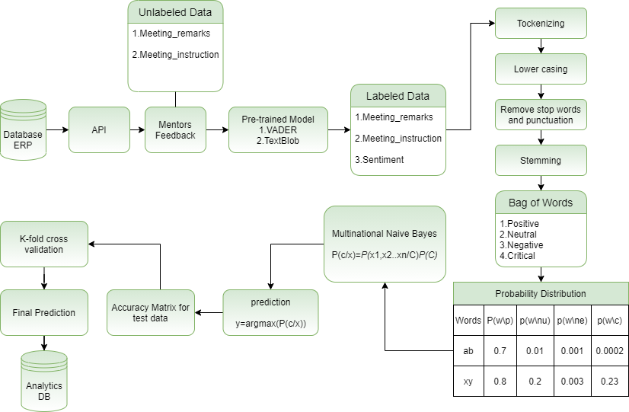
Process Workflow

